Slide 1
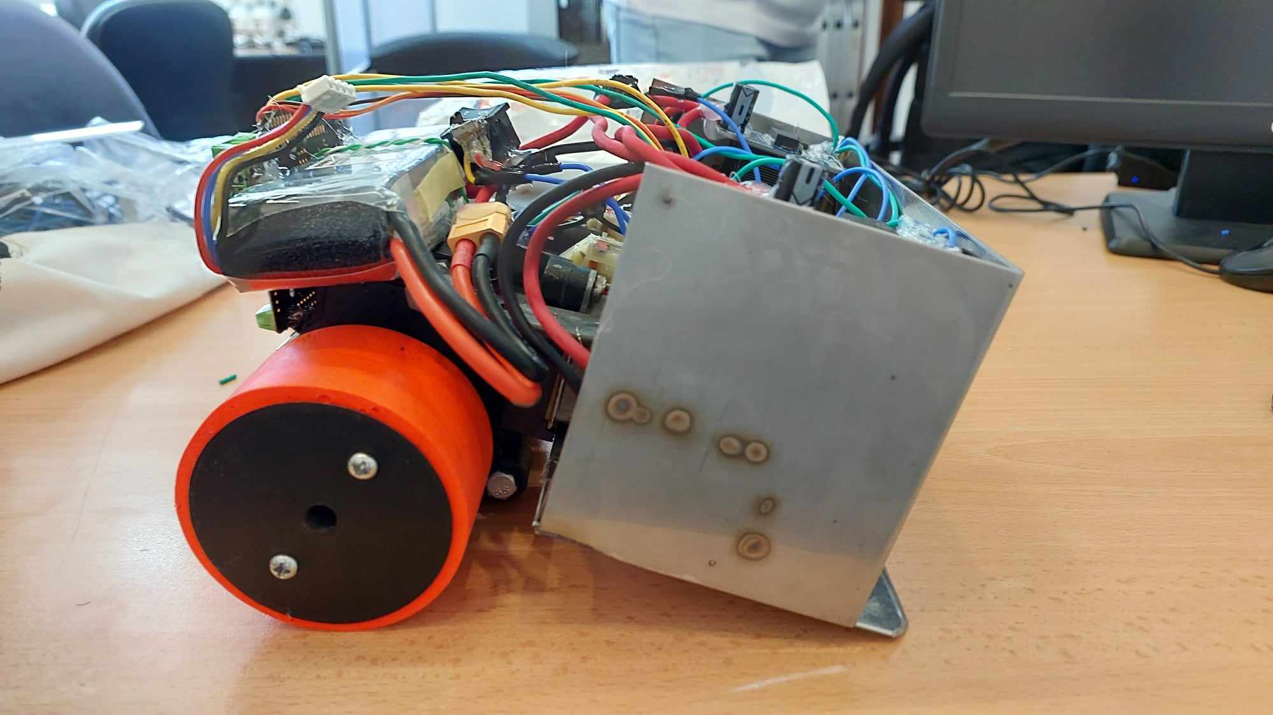
Mastering MPC USING MATLAB
SUMO ROBOT

Slide 2
Overview
Introduction
Mathematical
Model
MPC Parameters
MPC
Performance
Conclusion
PID performance

Slide 3
What is the sumo robot ?
It is a robotics competition category that simulates the Japanese national wrestling sport. The autonomous type is operated by itself with a computer code loaded into its system.

Slide 4
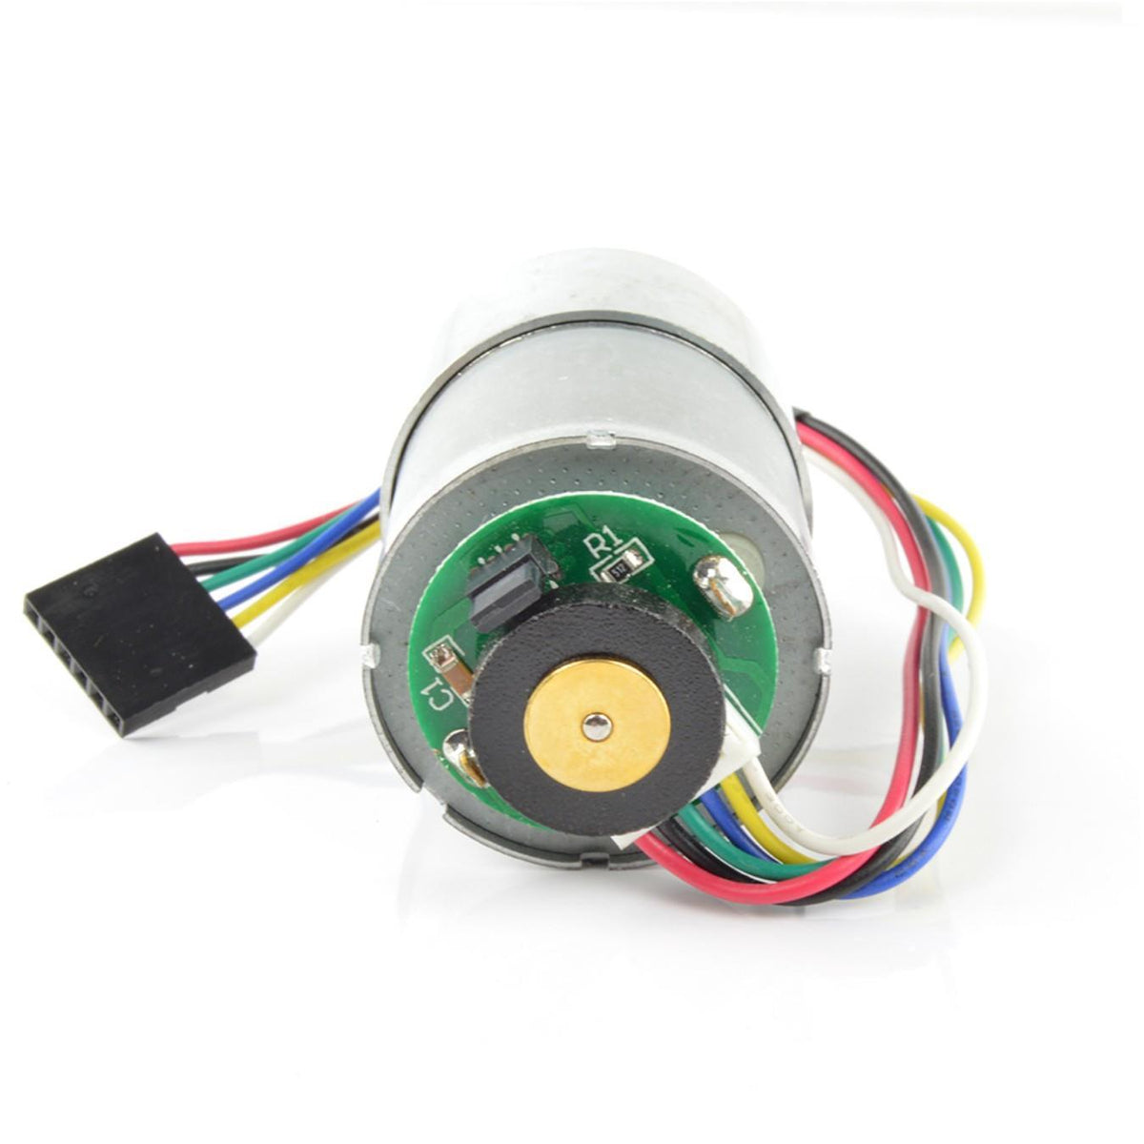
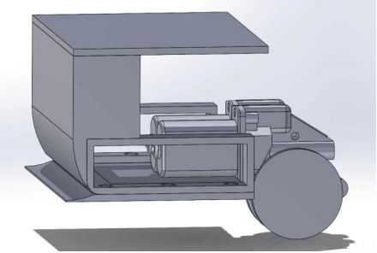
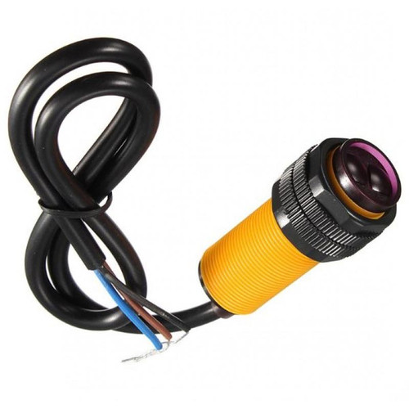

Hardware Components

Slide 5
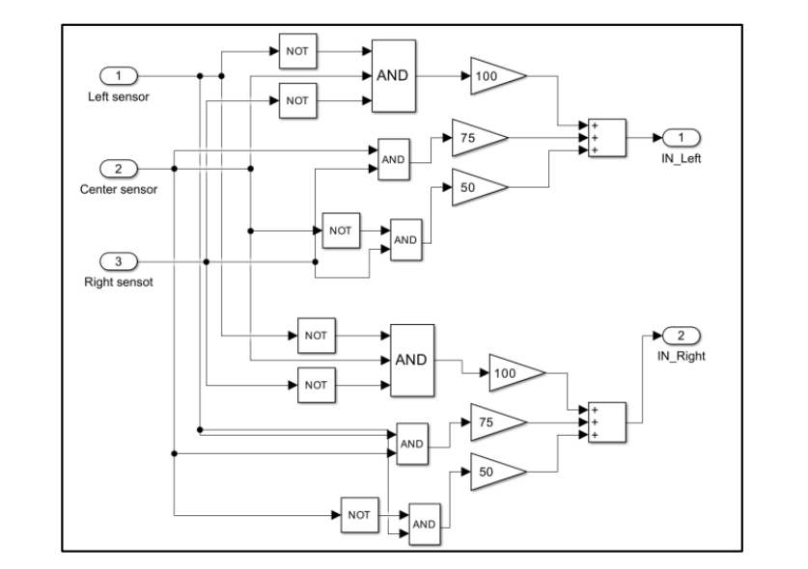
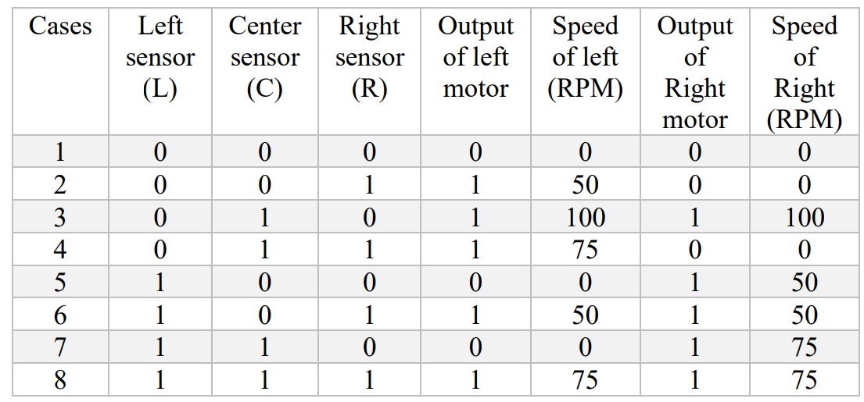
Sensors-Motors relationship

Slide 6

Mathematical Model
DC motor modeling
For a dc motor open-loop dynamic equation is:
$$L\frac{di}{dt}+iR+k_{b}\overline{ω}=V$$
$$J\frac{dω}{dt}=k_{t}i+T_{d}$$
In this study, DC motor with encoder is used. The model parameters are shown in Table 1
Parameters | Nominal
R_{a} (Armature Resistance) | 22 ohms
L_{a} (Armature Inductance) | 100 mH
Nominal Voltage | 5V

Slide 7
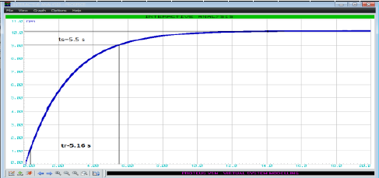

Mathematical Model
In order to obtain the characteristics of the system, the system feed with several step voltage have magnitude at 14V and 15V.
$Estimated transfer function=\frac{0.676}{0.5833s^{2}+2.629s+1}$

Slide 8
PID Performance
Sr No | Parameters | Without controller simulator | Simulated value PI | Simulated value PD | Simulated value PID | Tuning with C++
1 | Settling Time | 0.978 | 6.96 sec | 0.467 | 7.29 sec | 10.009
2 | Rise Time | 0.4401 | 1.75 sec | 0.109 | 1.99 sec | 10.009
3 | MP | 0 | 12% | 15.5% | 7.51% | 1.214%
4 | Ess (AT 100 RPM) | 59.2 | 0.765 | 1.6 | 0.14 | 4.9

Slide 9
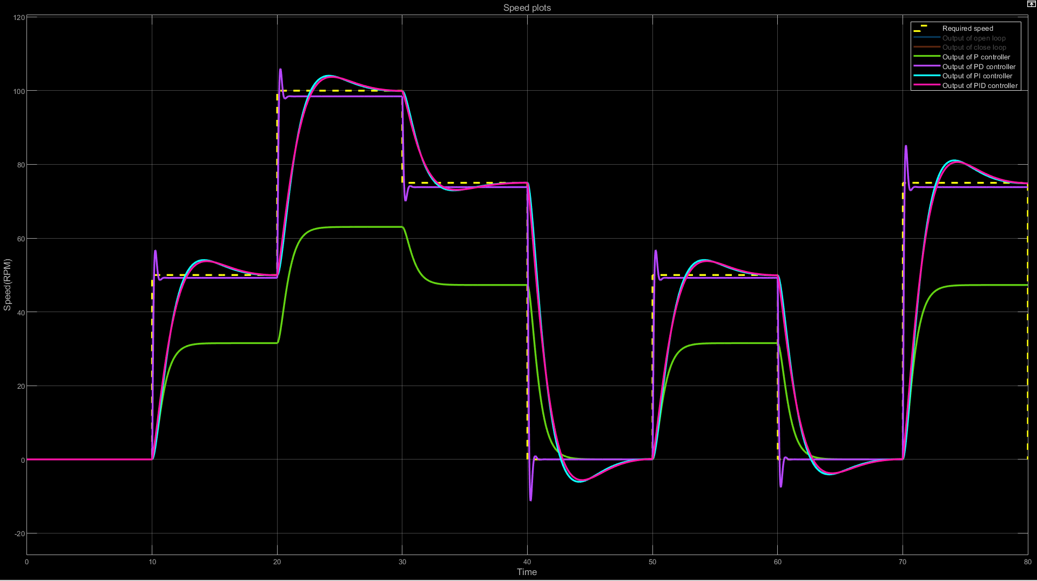

Slide 10
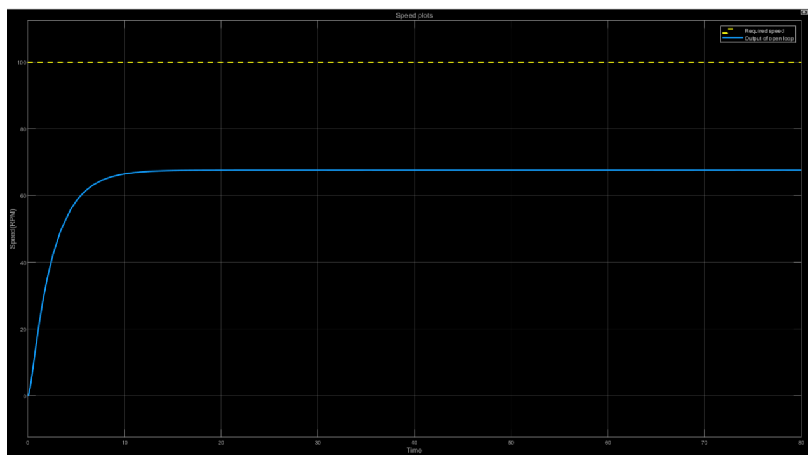
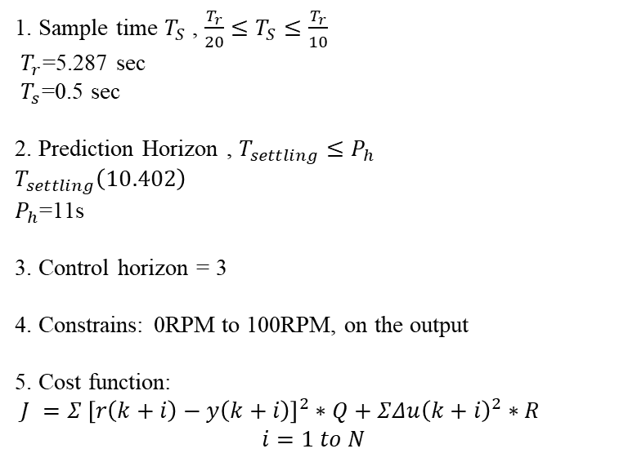
MPC Parameters
1. Sample time $T_{S}$ , $\frac{T_{r}}{20}≤T_{S}≤\frac{T_{r}}{10}$
$T_{r}$=5.287 sec
$T_{s}$=0.5 sec
2. Prediction Horizon , $T_{settling}≤P_{h}$
$$T_{settling}\left(10.402\right)$$
$P_{h}$=11s
3. Control horizon = 3
4. Constrains: 0RPM to 100RPM, on the output
5. Cost function:
$J =Σ {\left[r\left(k+i\right)−y\left(k+i\right)\right]}^{2}∗Q+ΣΔu{\left(k+i\right)}^{2}∗R$
$$i=1 to N$$

Slide 11
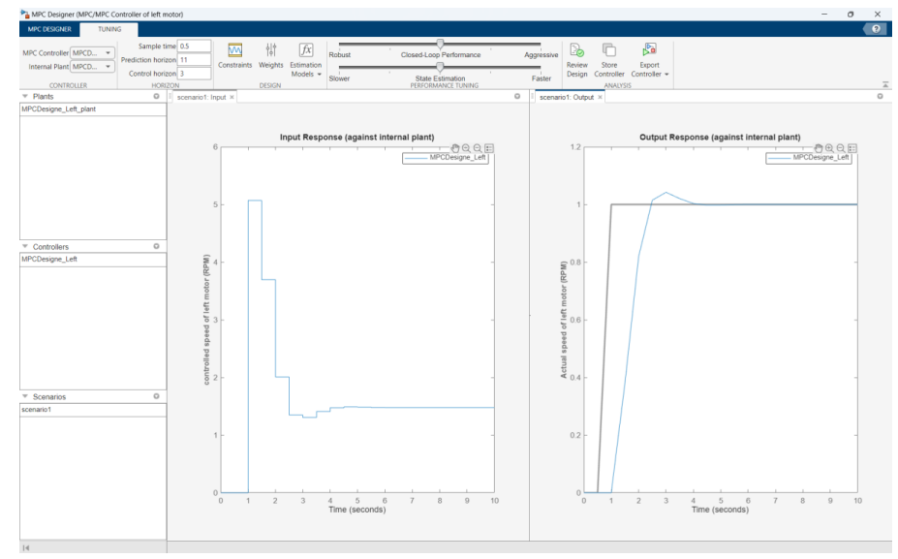
MPC Parameters

Slide 12
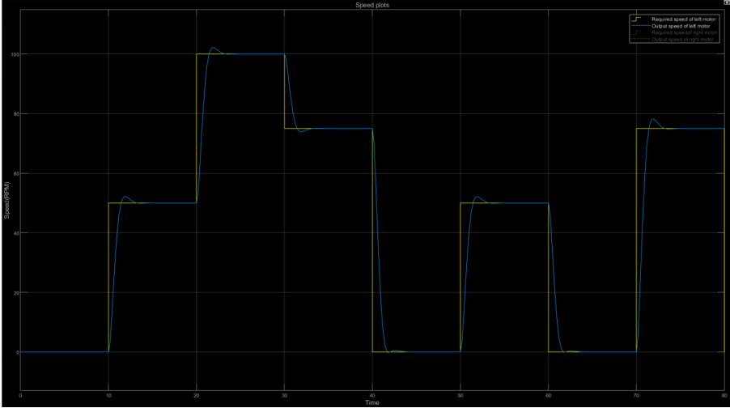
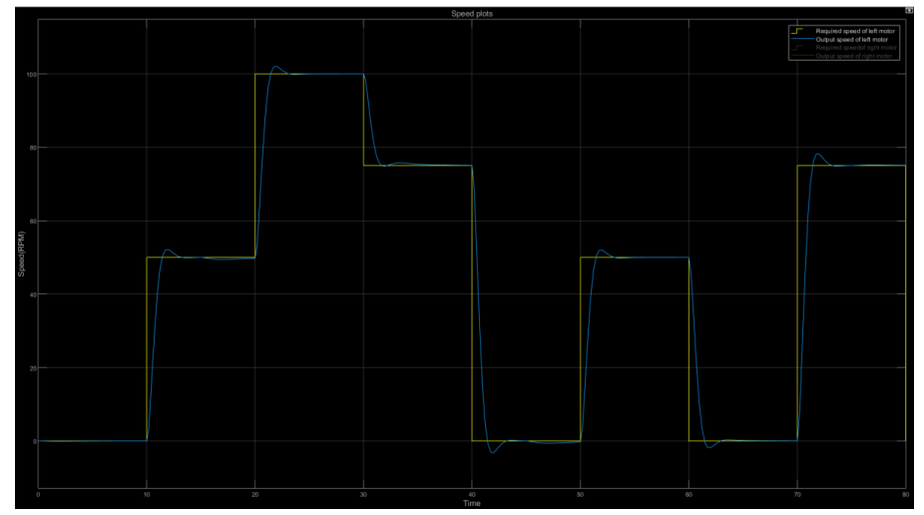
MPC Performance

Slide 13
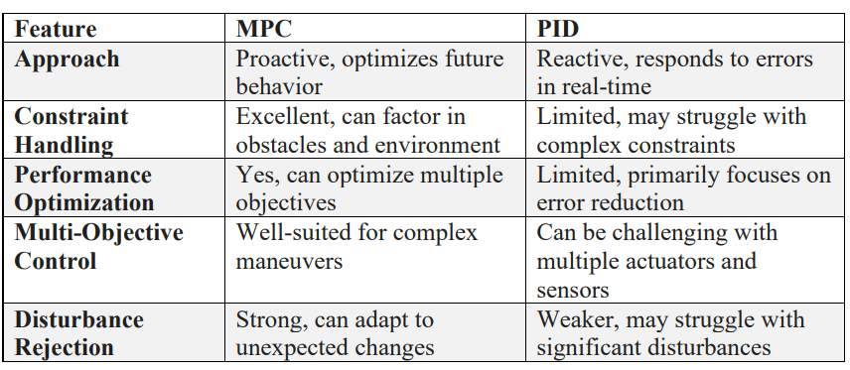
Conclusion

Slide 14
Thank you
Any questions?

